Slide 1
Feature detection and matching
DETECTION OF MULTIPLE OBJECT IN A SCENE
Project 8 by Sara Barozzi and Matteo Guidi
Academic Year 2017-2018

Slide 2
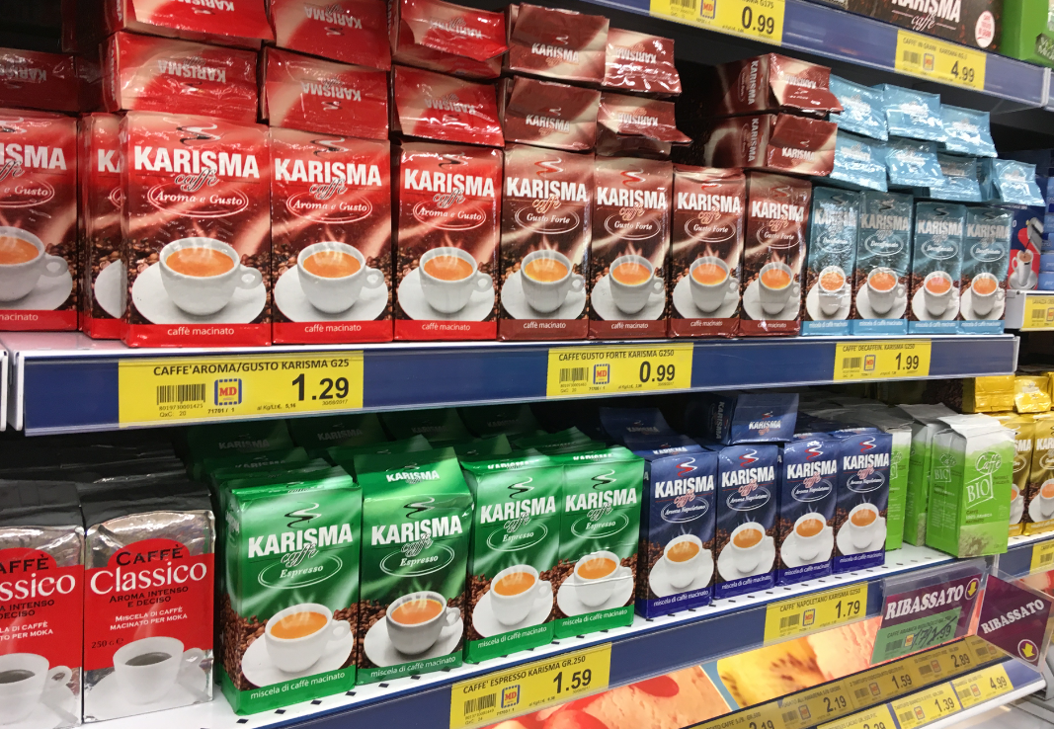
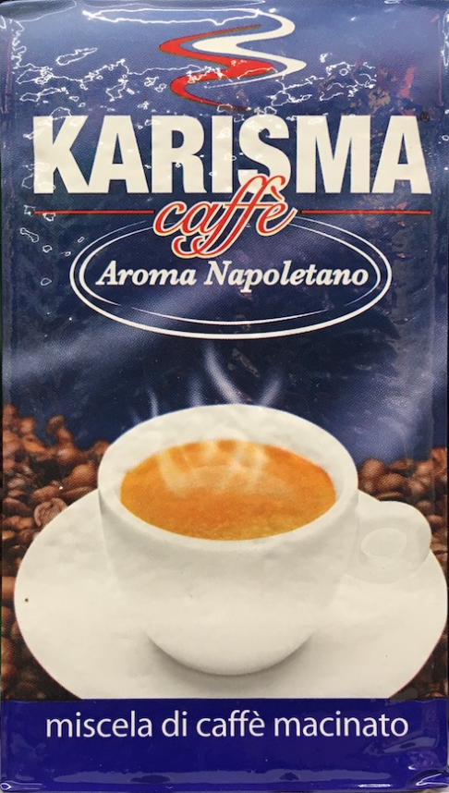
PROBLEM STATEMENT
We want to detect all the multiple repetitions of the same template inside an image
Case studied: Multiple, planar and rectangular shaped objects
Template
Image

Slide 3
METHOD
Select image and template
Feature extraction with SURF
Feature matching by minimizing euclidean distance
Ratio test to discard false matches
Retrieval of the regions of interest (ROI)
Rectification and resising of ROI
Select ROI based on euclidean distance
Select ROI based on histogram comparison
Final visualization of results

Slide 4
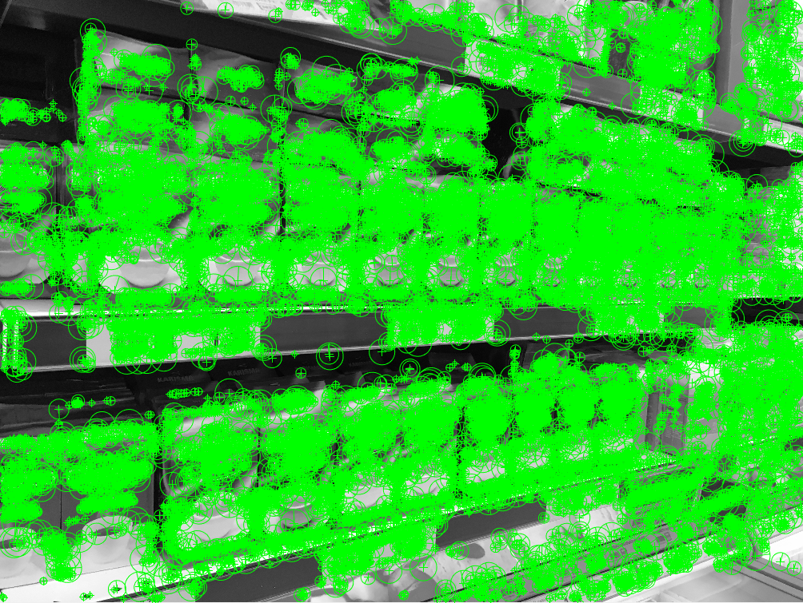
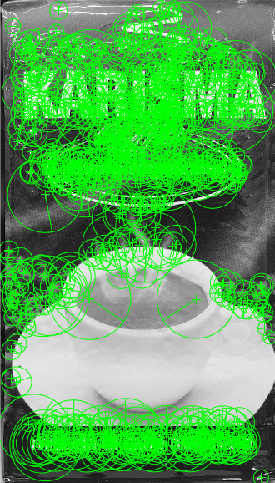
FEATURE EXTRACTION
The first step to be done is a feature extraction from both image and template.
In order to extract the features we decided to use SURF algorithm.

Slide 5
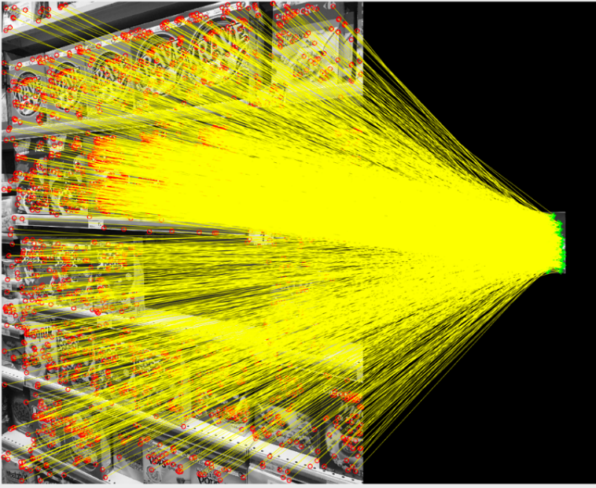
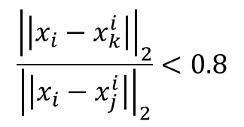
FEATURE MATCHING
The features extracted are matched based on the euclidean distance between their descriptors;
A ratio test is performed to discard the ambiguos and false matches using the formula:
$$\frac{{\left|\left|x_{i}−x_{k}^{i}\right|\right|}_{2}}{{\left|\left|x_{i}−x_{j}^{i}\right|\right|}_{2}}<0.8$$

Slide 6
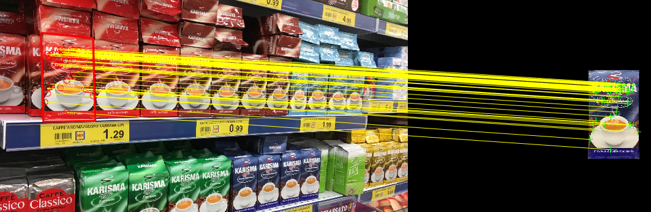
RETRIEVAL OF THE REGIONS OF INTEREST (1/2)
Use a MSAC algorithm to estimate the projective geometric transformation between the template and the object located in the image;
Find the box surrounding the reproduction of the template in the picture;
Eliminate all the degenerate and out of bounds boxes;

Slide 7
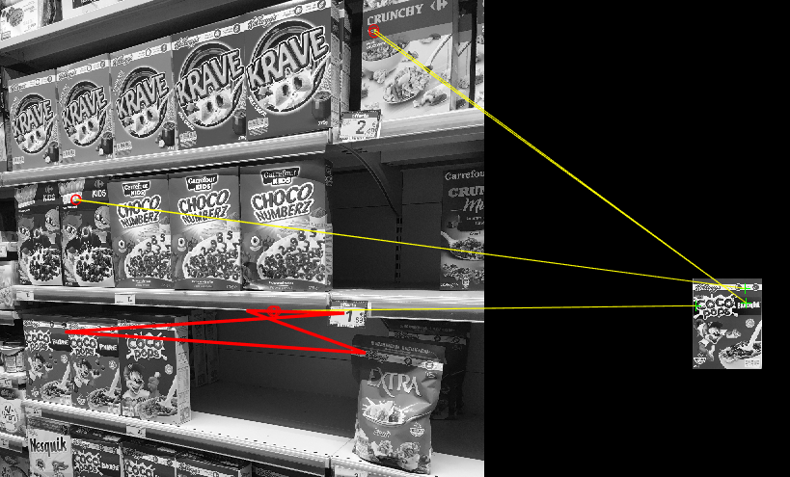
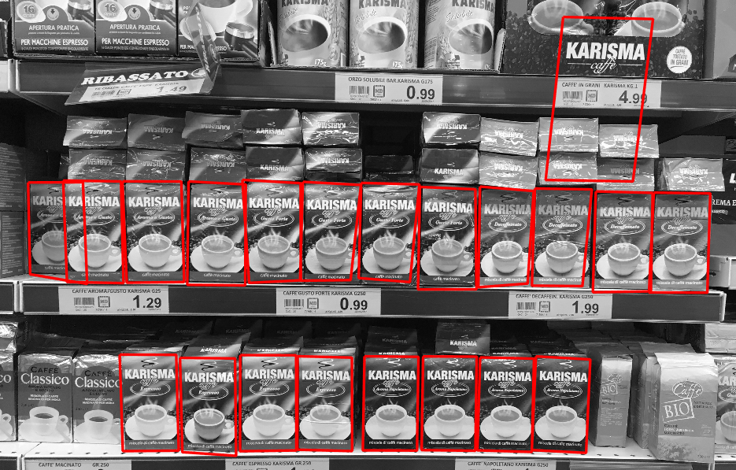
RETRIEVAL OF THE REGIONS OF INTEREST (2/2)
Some wrong matches are found:
Colour differences are not detected
Identical parts matching

Slide 8
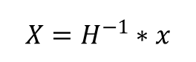
BOXES RECTIFICATION
For each detected projective transformation that relates template and ROI, find the inverse transformation to rectify the boxes.
Resize all the boxes to the dimension of the template to be able to compare them.
Do an histogram equalization of each BW image found to obtain a better comparison result.
$$X=H^{−1}∗x$$

Slide 9
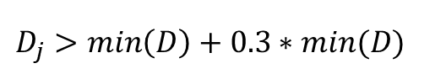
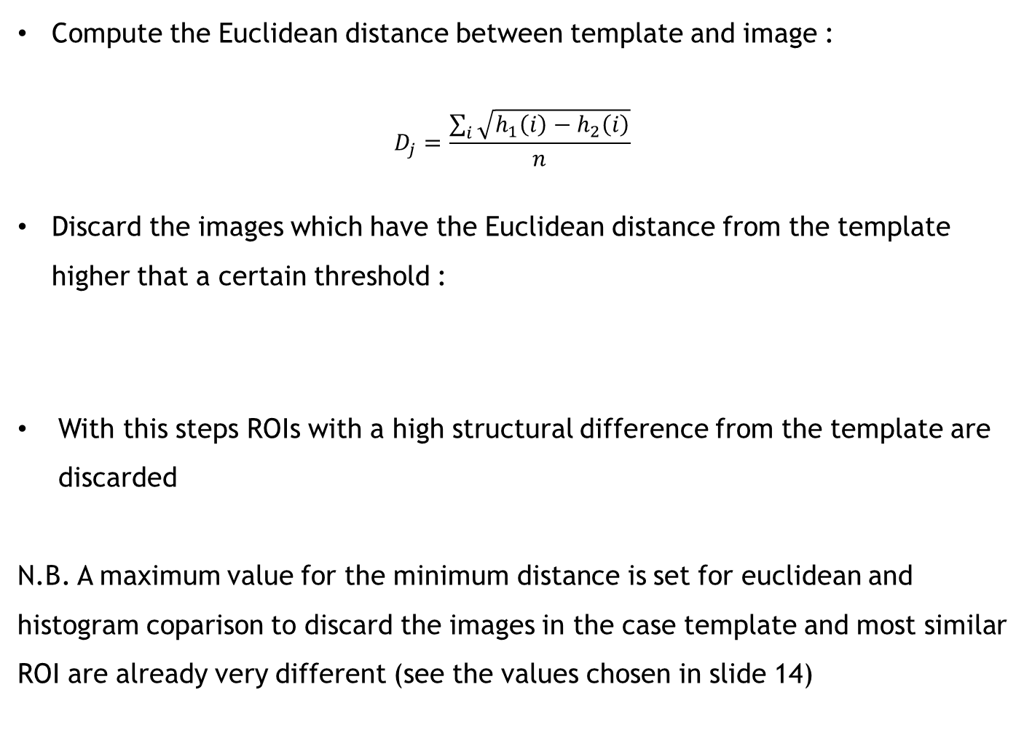
EUCLIDIEAN DISTANCE COMPARISON (1/2)
Compute the Euclidean distance between template and image :
$$D_{j}=\frac{\sum_{i}{\sqrt{h_{1}\left(i\right)−h_{2}\left(i\right)}}}{n}$$
Discard the images which have the Euclidean distance from the template higher that a certain threshold :
With this steps ROIs with a high structural difference from the template are discarded
N.B. A maximum value for the minimum distance is set for euclidean and histogram coparison to discard the images in the case template and most similar ROI are already very different (see the values chosen in slide 14)
$D_{j}>\min\left(D\right)+0.3∗min(D)$

Slide 10
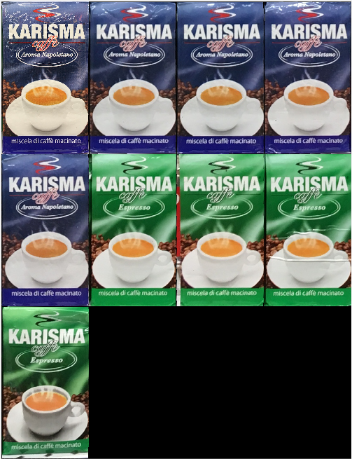
EUCLIDIEAN DISTANCE COMPARISON (2/2)
Example of extracted ROI and their distances from the template;
1 2 3 4 5 6 7 8

Slide 11

HISTOGRAM DISTANCE COMPARISON (1/2)
In order to remove brightness and shades problem, the ROIs found are equalized with respect to the template
Compute the histogram distance between template and the ROI in RGB coming from the precedent step.
Chi square statistic is used to asses the similarity between the pictgures
Discard the ROI which have a distance from the template higher that a certain threshold
With this passage we can discard ROI of completely different color with respect to the template
${D′}_{j}>\min\left(D\right)+2∗min(D)$

Slide 12
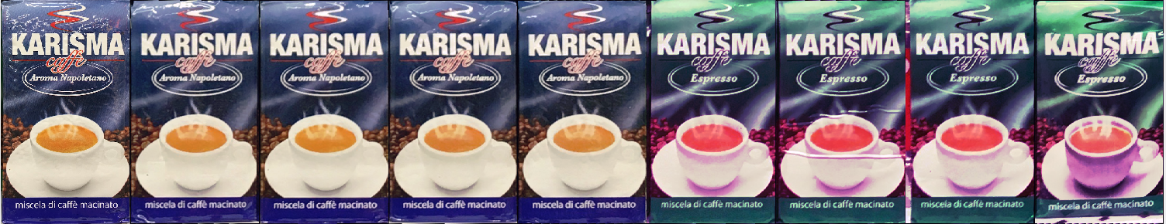
HISTOGRAM DISTANCE COMPARISON (2/2)
Example of equalized ROI and their distances from the template;
1 2 3 4 5 6 7 8

Slide 13
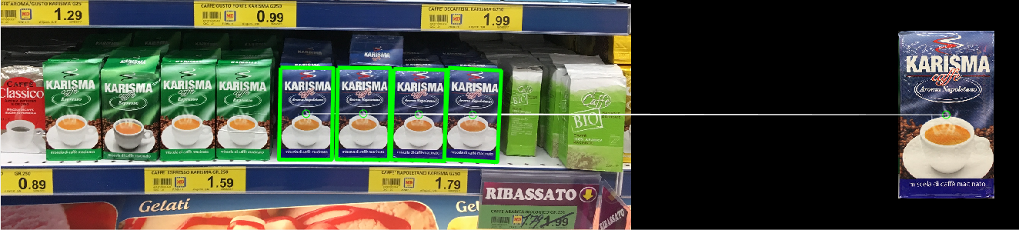
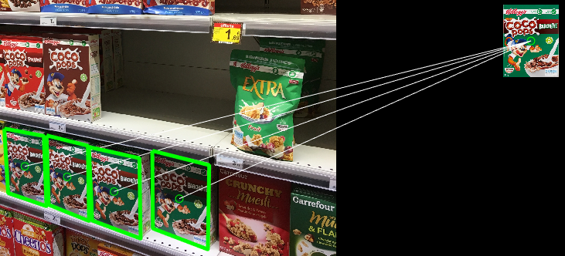
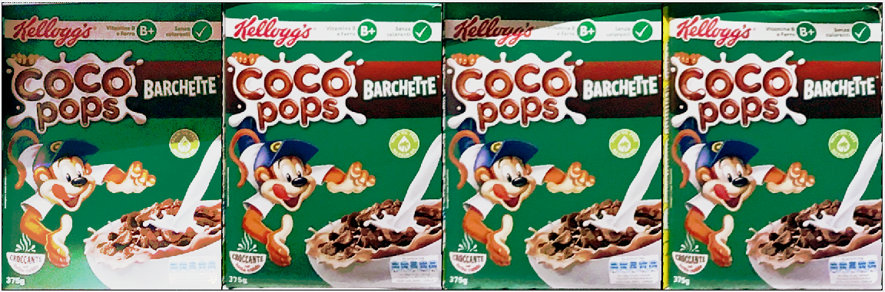
VISUALIZATION OF THE FINAL RESULT
Final objects in the scene and rectification of the object detected

Slide 14
OPERATIONAL PARAMETER
The choise of the opeation parameter has been done with empirical processes;
SSIM has been used to test that our procedure gives exact results;
Test on the execution time of the most time requiring operation have been done to choose a parameter that could provide good quality and short lenght of process.
MIN_NUM_INLIER = 10;
MAX_NUM_BOX = Inf;
MAX_NUM_TRIAL = 50000;
MAX_DISTEUC = 0.25;
percent_eu = 30;
MAX_DISTHIST = 0.1;
perc_dist_hist= 200;
MIN_SSIMVAL = 0.4;
percent_ssim = 25;

Slide 15
CONCLUSION
Out technique is able to detect multiple occurences of the tempalte inside the image in different cases:
Frontal images
Lateral images
Images with a lot of repetitions to be found
Shaded zones in the image
Differences between ROI and template that can be recognised:
Variation in the color
Variation in the structure

Slide 16
Thanks!

